Slide 1
Amazon Rainforest Research Requirements & Intro to Noodletools 2017
Computer>TRN_Shared>TOR Library Media Center folder>Pavia and Curto Amazon Rainforest folder
Mr. Pavia & Mr. Curto ☺
Presentation created by Lynn Murray
May 2017 10

Slide 2
What’s the “big picture”?
1. Topic
2. Impact
3. Resolution

Slide 3
Research Steps

Slide 4
Research steps delineated:
Read the Project Guidelines on slide six.
Write your thesis statement on slide seven.
Read the outline questions for Noodletools on slide eight. Compare them to the questions in your packet and make changes if necessary.
Read about our project resources on slide 9.
Login to Noodletools on slide 20 to write your research question, thesis statement, and outline.
Locate and read hard cover book and encyclopedia text about your topic. Write book note cards about your topic on Noodletools.
Locate and read database text about your topic from Newsbank and Grolier. Write website note cards about your topic on Noodletools.
Create a presentation about your note cards. See the bottom of slide six for presentation options.

Slide 5
Guidelines for the Amazon Rainforest Research Project

Slide 6
Alternate ecosystems:
-Andes Mountains
-Pampas
-Patagonia
-Lake Titicaca
Guidelines for the Amazon Rainforest Project
Project topics/issues: Your project may include but are not limited to such issues as:
Environmental issues and economics:
-deforestation and the effect on economies in South America
-mining for minerals and drilling for oil in the Amazon basin and it’s consequences for the forest and indigenous cultures
-natural resources found in the Amazon region and their uses worldwide
Cultural Issues:
-research indigenous tribes in the Amazon region and create thematic maps and graphs to show how they have been affected by the destruction of their environment
-research one indigenous tribe from the Amazon region and write their history, culture, and way of life in the rainforest.
Plants and Animals:
-what plants found in the Amazon rainforest are used for special purposes, such as medicines, ingredients for skin and hair products, etc.
-research the animals that have lost their homes due to the development of the Amazon, where do they go? What animals are endangered or close to being endangered as a result of the destruction of their habitat.
Presentation requirements:
Each presentation must include ample visuals (pictures, graphs, charts) and a separate Works Cited page with correct MLA citations.
Presentations options:
District-purchased Powerpoint
District-purchased Photostory or Windows Movie Maker movie
District-purchased Promethean flipchart
District-purchased Scratch presentation with a separate written piece
Tri-fold board with pictures, graphs and facts and a separate written piece
Models or large maps and a separate written piece
Essay with pictures, graphs, and charts
Skit with separate written piece
Dance with separate written piece
Talk show with separate written piece
Sculpture or diorama with separate written piece

Slide 7
Write a complete thesis statement. Thesis statement: topic, impact and resolution
Sample:
Topic: Mining for minerals
Impact: Negative impact on native communities of the Amazon Rainforest
Resolution: Possible solutions
Thesis: Mining has had a negative impact on the native communities of the Amazon Rainforest yet there are solutions that may help.
Topic:
Impact:
Resolution:
Thesis statement:

Slide 8
Outline Questions for Noodletools : Compare these questions to your own and add/delete questions if applicable.
Slide 8
I. Topic=Amazon Rainforest (mining, animals, deforestation, etc.)
What is your topic? Describe it.
Where is the topic taking place within the Amazon Rainforest?
What groups of people are involved with your topic?
How long has the problem been taking place?
II. Impact
What impact has your topic had on the rainforest? OR How has your topic been affected by deforestation?
What changes have occurred because of your topic?
Who (groups) is responsible for your problem continuing to exist?
III. Resolution and Reflection
What can be done to help solve the current situation? Include two or three possible solutions.
Which of the possible solutions do you think will be most successful and why?

Slide 9
Amazon Project Resources ☺
Tax-purchased hard cover books on reserve and encyclopedias.
Tax-purchased database text:
Newsbank
Grolier
Bigchalk & Elibrary
Approved free websites: Use these AFTER you’ve used the sources above.
World Wildlife Fund: Amazon Threats
http://wwf.panda.org/what_we_do/where_we_work/amazon/about_the_amazon/ecosystems_amazon/rainforests/index.cfm
Mongabay: Amazon Rainforest background information
http://rainforests.mongabay.com/amazon/
The Nature Conservancy: Latin America Page
Good for identifying alternative ecosystems in Latin America that are under threat.
https://www.nature.org/ourinitiatives/regions/latinamerica/index.htm
IWGIA: International Work Group for Indigenous Affairs
Good for identifying indigenous groups throughout Latin America and threats to their survival.
http://www.iwgia.org/regions/latin-america/indigenous-peoples-in-latin-america

Slide 10
Grolier

Slide 12
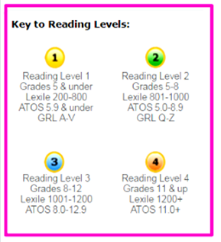

Slide 15
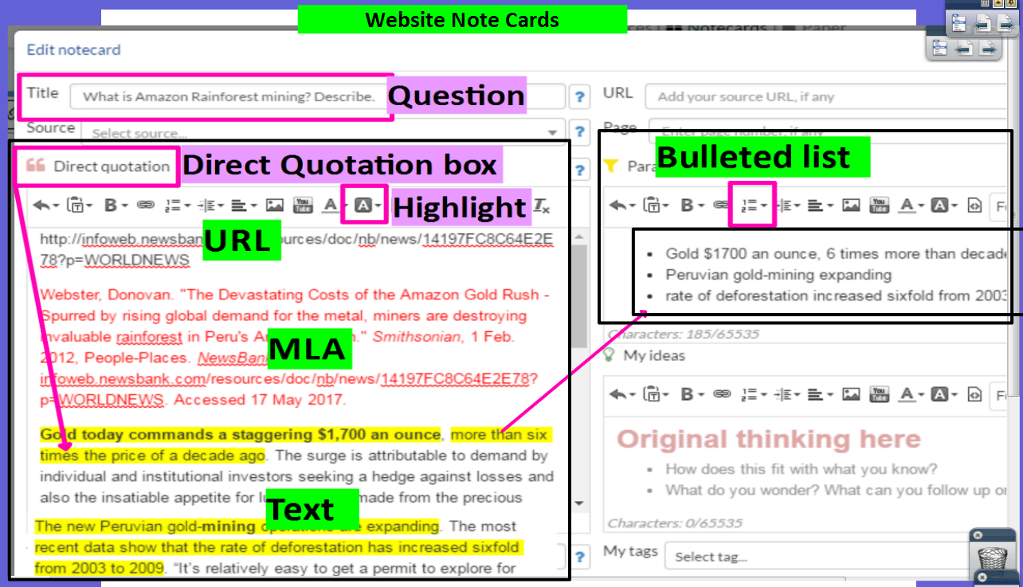
Copy and paste database text into the Direct Quotation box on Noodletools. Organize text onto “mini” Cornell Notes.
Noodletools Website Note Card
“Mini” Cornell Notes

Slide 16
Bigchalk & ELibrary

Slide 18
Split Screen Note-taking = Locate Database text: Bigchalk Students Locate + Read + Annotate + Organize + Cite + Write about district-purchased nonfiction text.
Your topic

Slide 20
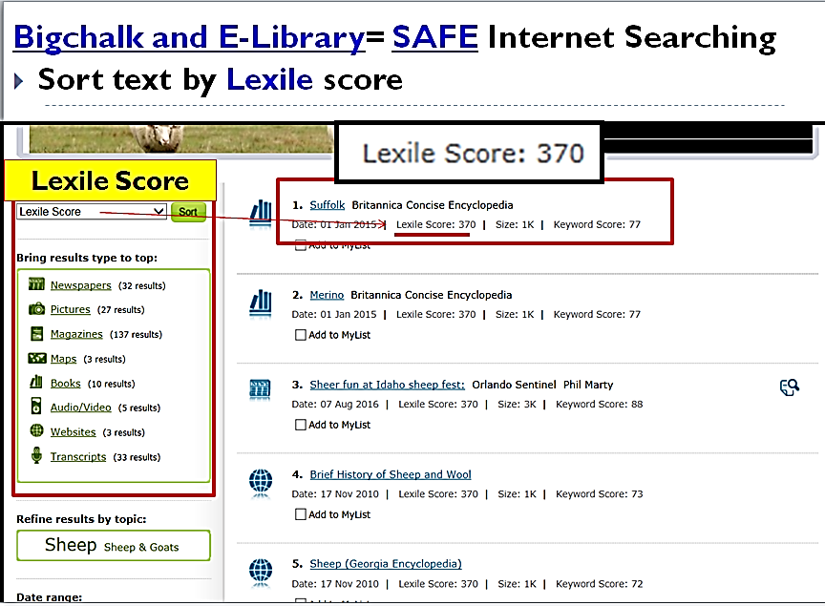
Split Screen Note-taking = Locate Database text: Bigchalk Students Locate + Read + Annotate + Organize + Cite + Write about district-purchased nonfiction text. Bigchalk & ELibrary

Slide 21
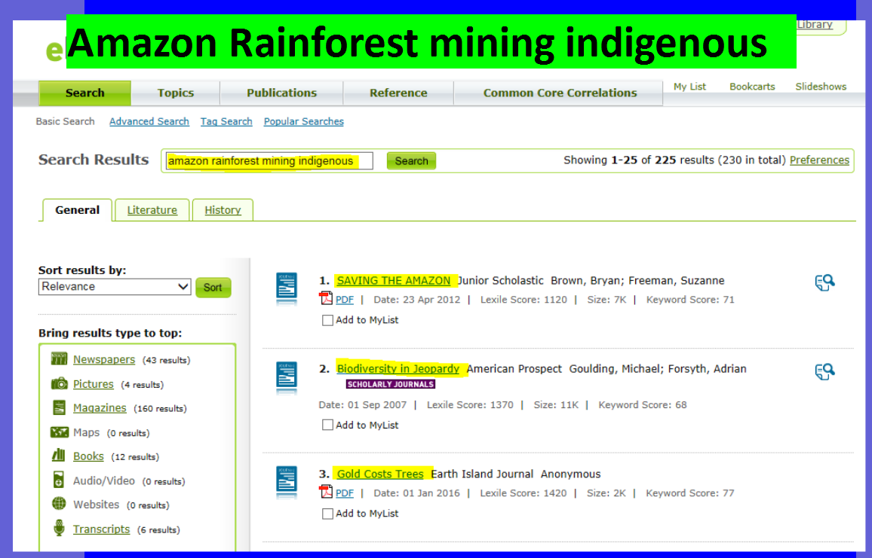

Slide 22
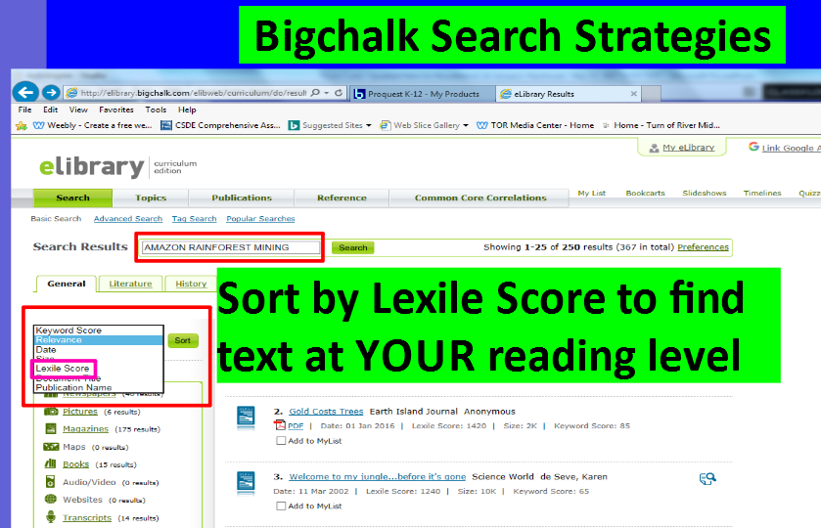

Slide 24
Copy and paste database text into the Direct Quotation box on Noodletools. Organize text onto “mini” Cornell Notes.
Noodletools Website Note Card
“Mini” Cornell Notes

Slide 25
Newsbank

Slide 26
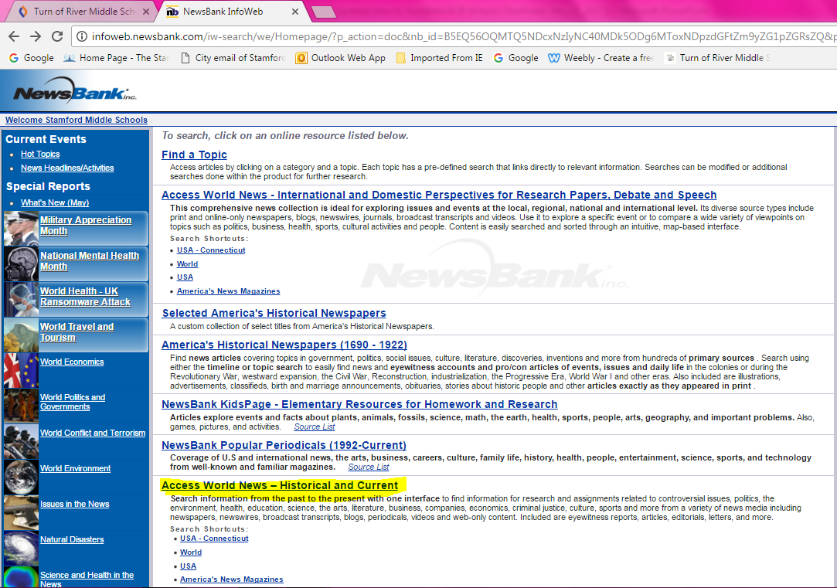
Newsbank is AWESOME!!!
Newsbank: TORonline.org>TOR Media Center>Scroll down to Destiny Book Catalog & SPS Database Access>TOR>Newsbank>Access World News
Click on Access World News-Historical and Current

Slide 27
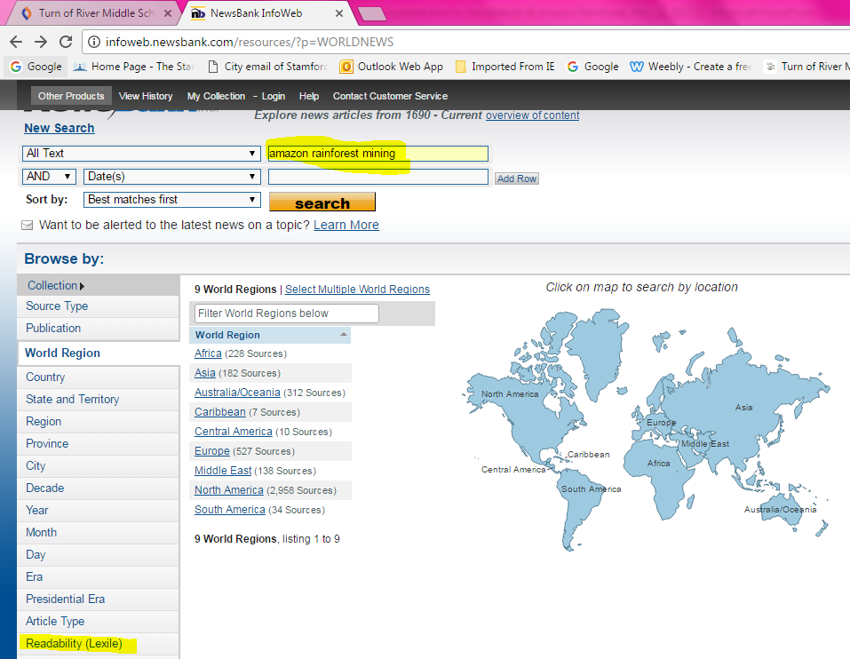
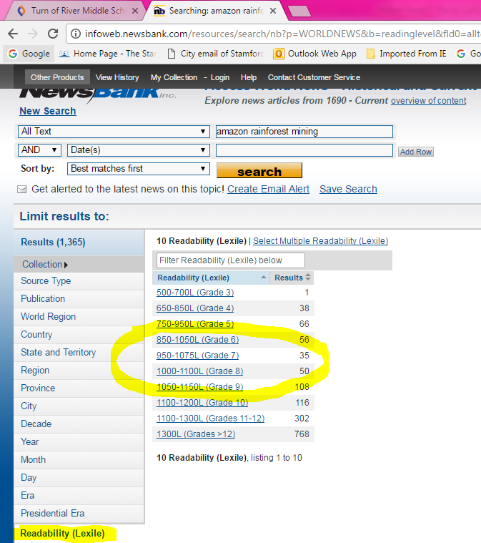
Newsbank is AWESOME!!!
B. Newsbank: Type your topic>Click on Readability>Choose a reading level.
1. Type your topic
3. Choose a reading level.
2. Click on Readability (Lexile)

Slide 28
Newsbank is AWESOME!!!
C. Scroll down and read through the titles and abstracts. Click on a title that looks good.
Wow!!!

Slide 29
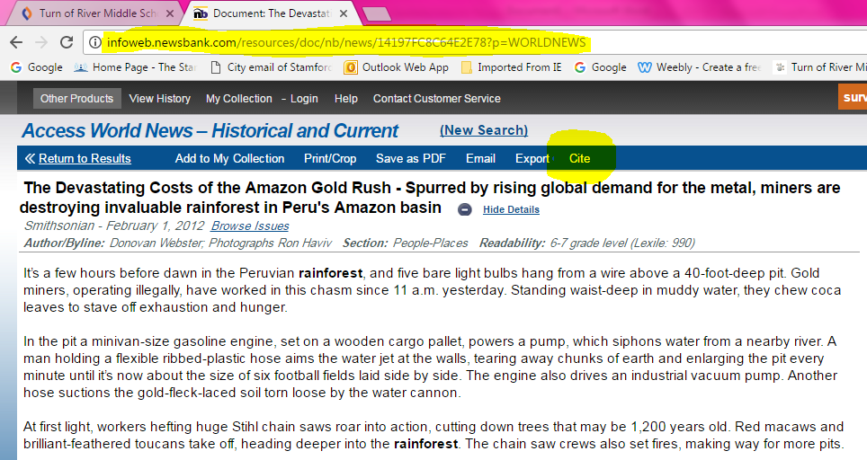
Newsbank is AWESOME!!!
D. READ the article!!!! Copy the URL, MLA citation and text about your topic.
URL
Cite
MLA Citation
Text about
your topic!!!

Slide 31
Copy and paste database text into the Direct Quotation box on Noodletools. Organize text onto “mini” Cornell Notes.
Noodletools Website Note Card
“Mini” Cornell Notes

Slide 32
Noodletools
It’s a website that allows you to organize your outline, note cards, and Works Cited information online!

Slide 34
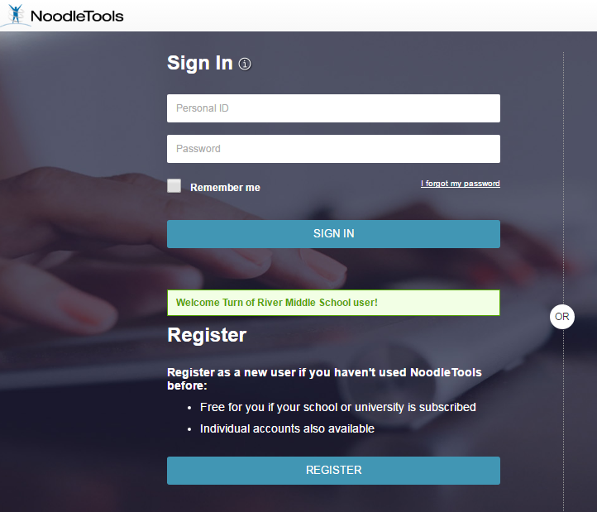
Register

Slide 35
Click on +New Project to begin a new research project.

Slide 36
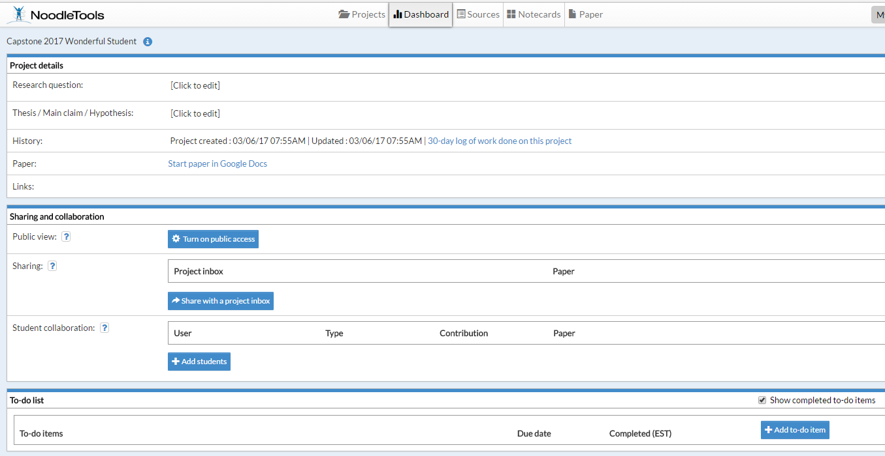
The Dashing Dashboard
Click to edit to type your RESEARCH QUESTION. Example=How does mining in the Amazon basin affect the forest and its indigenous cultures?
Created & Updated by Lynn Murray February 2016

Slide 37
Click on Notecards: Create an outline about your topic.

Slide 38
Split the screen so this PowerPoint is on the left and Noodletools is on the right.

Slide 39
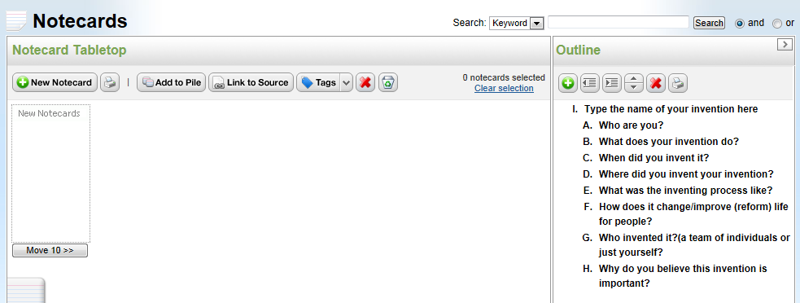
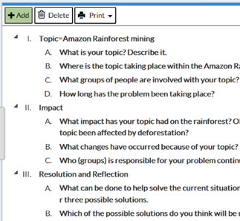
Click on New Notecard to begin taking notes about your topic.
Sample outline

Slide 40
Note Cards ☺ Website
What is the problem? Describe 2
Bullets and Lists
Copy, paste and highlight text here.

Slide 41
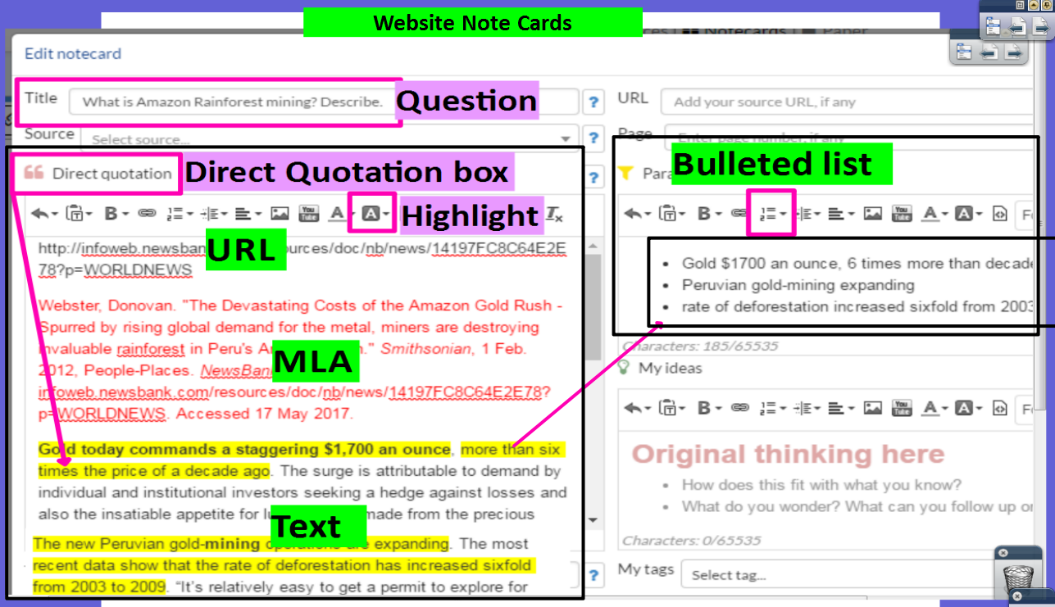

Slide 42
Note Cards ☺ Book
What is the problem? Describe 1
Book
Bullets and Lists

Slide 43
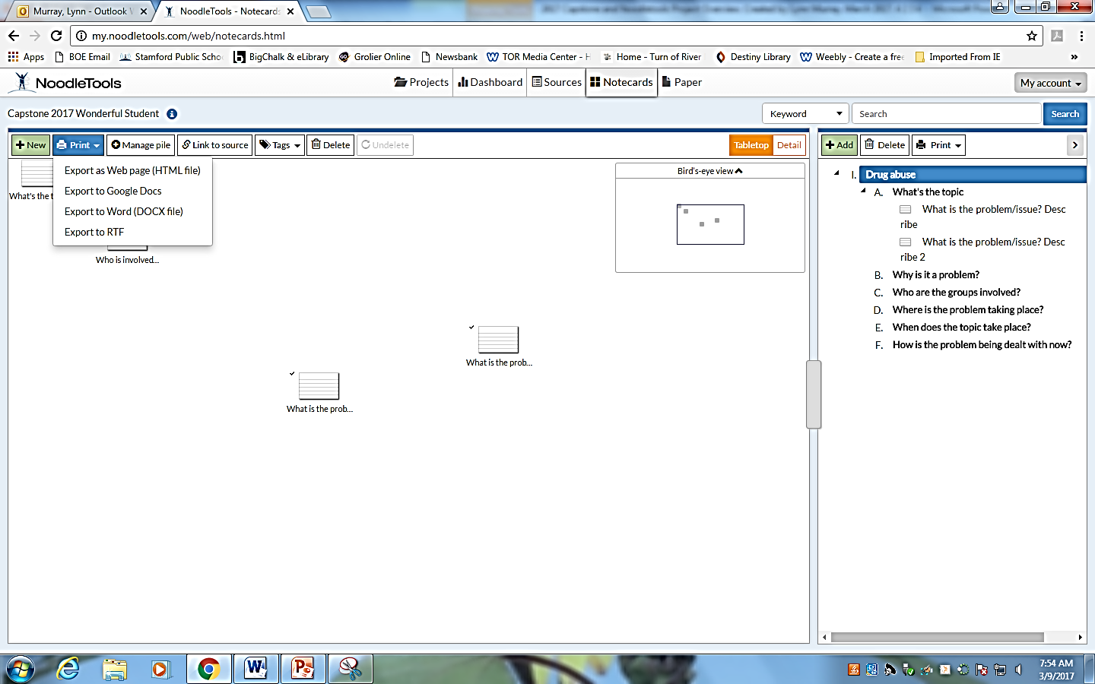
Note Cards on Dashboard
Print>Export to Word

Slide 44
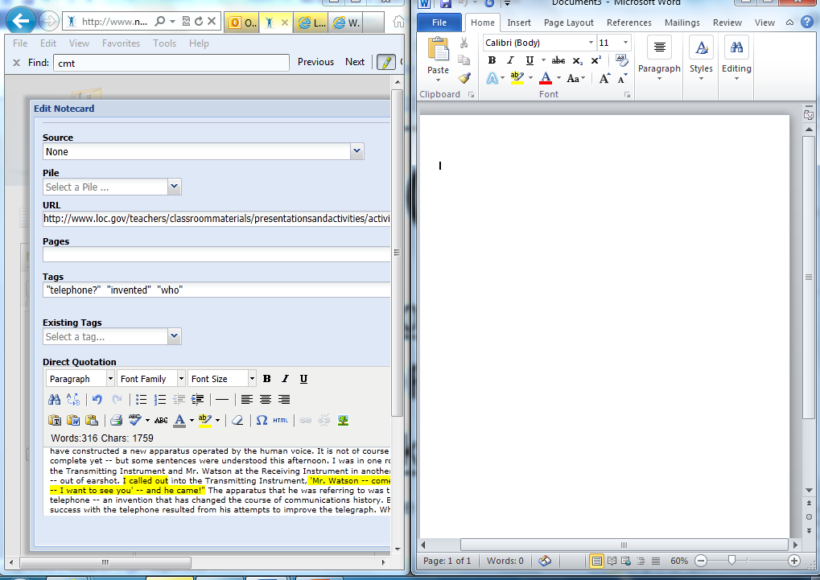
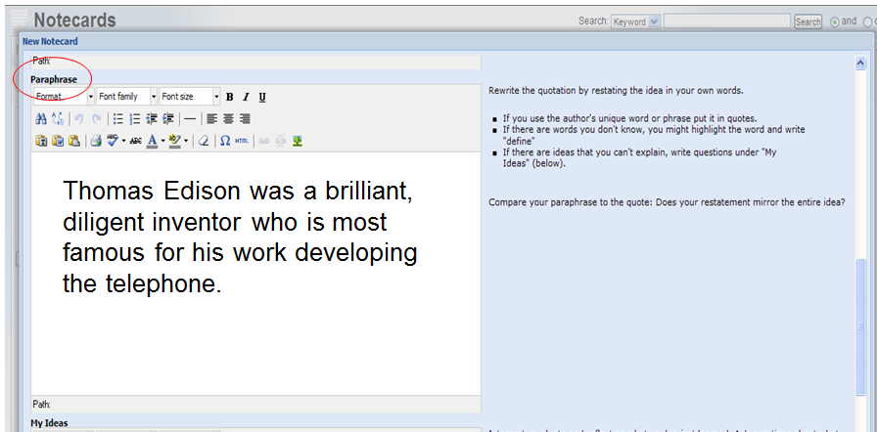
Split the screen so your notecard is on one side and Microsoft Word is on the other. Create your masterpiece on the right!
Open Word and split the screen to write your paper. Place Noodletools on your left and Word on your right. Look at your paraphrased information on the left to write your final masterpiece paper.
Use the Paraphrase section of your note cards to create your paper.
Create your masterpiece based upon your notecards here!

Slide 45
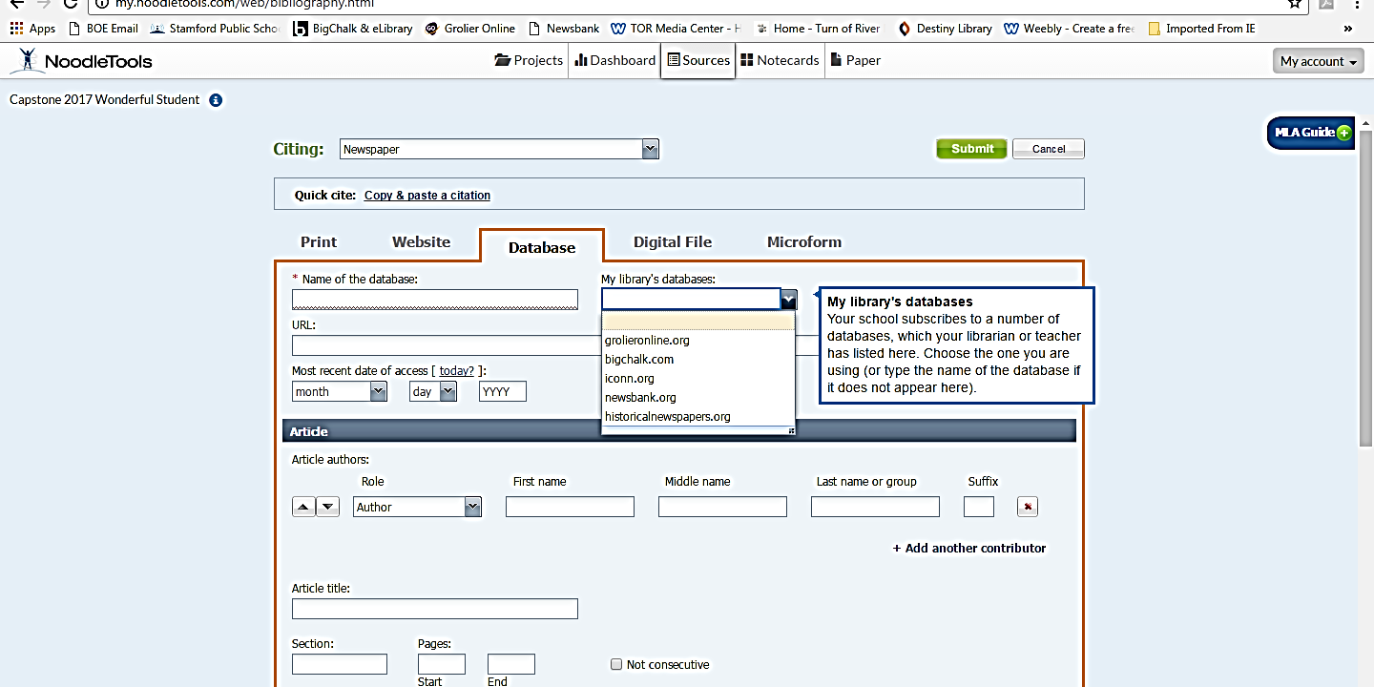
Book Sources on Noodletools
1
3
2
Book

Slide 46
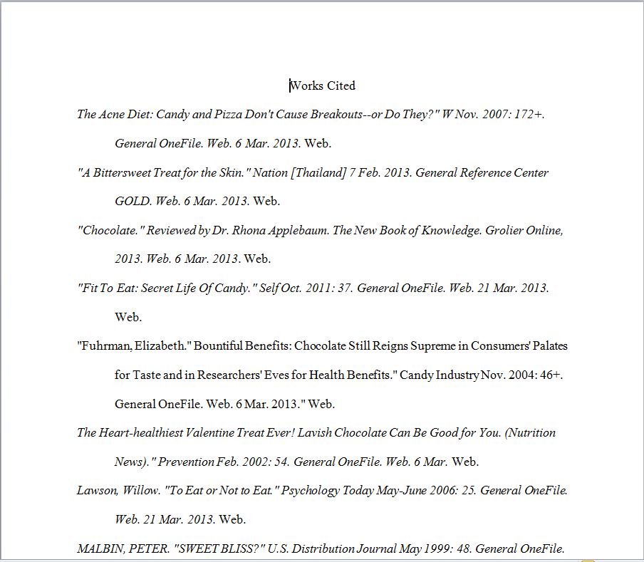
Create a Works Cited page. Copy and paste the MLA citations from your Notecards in alphabetical order to create a Works Cited page.
What is a Works Cited page?
It's a listing of book and computer sources that you used for your paper or project.
Each source (entry) is listed and alphabetized by its MLA format.
It's the last page of your paper and it's entitled Works Cited at the top.
Formatting requirements of the Works Cited page:
Double spaced.
Times New Roman font.
12 sized font.
Hanging indent. The first line is not indented. All of subsequent lines are indented, however.
Sample Works Cited

Slide 47
Good job!
☺
You Rock!!!

