Slide 1
Noodletools 2018 ☺
How to cite:
books
encyclopedias

Slide 2
Noodletools 2018
How to cite books

Slide 3
Noodletools Sources: Print Books and Encyclopedias
2
1
Create New Citation

Slide 4
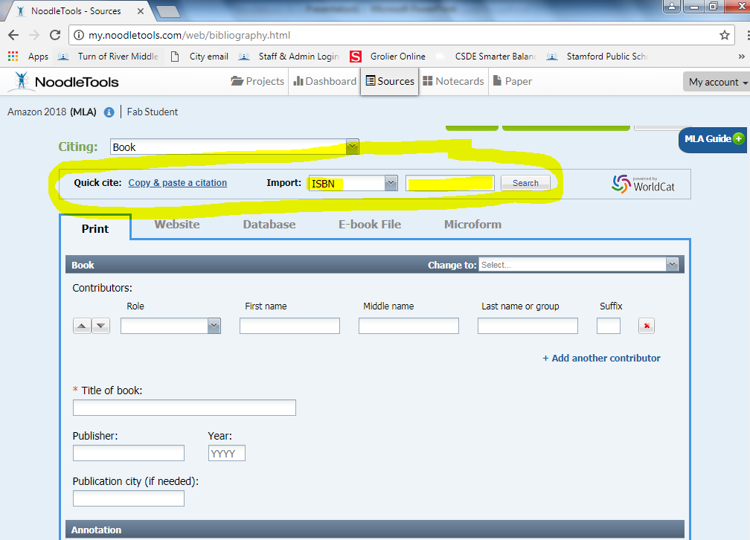
Noodletools Sources: Citing Books
1
2
ISBN Number ☺
3

Slide 5
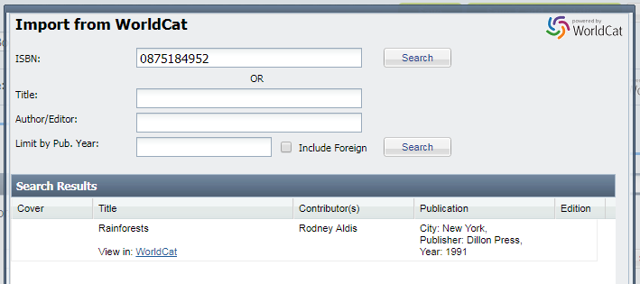
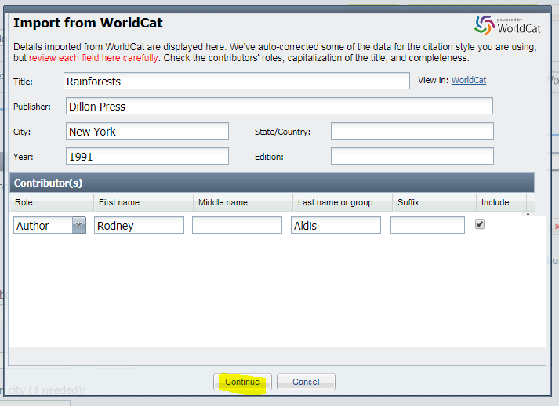
Noodletools Sources: Citing Books
1
2

Slide 6
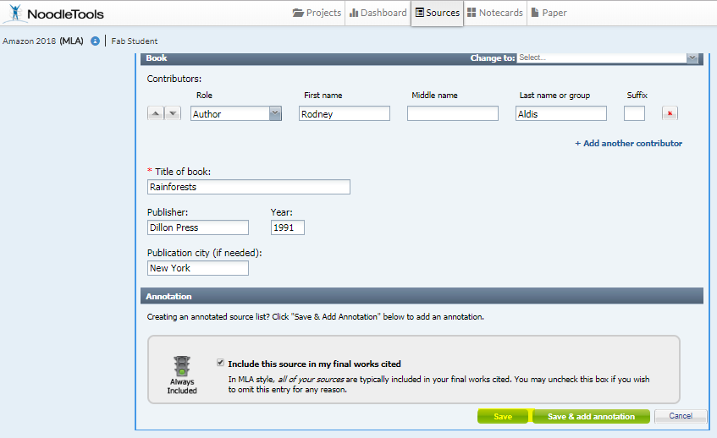
Noodletools Sources: Citing Books

Slide 7
Noodletools 2018
How to cite encyclopedias

Slide 8
Noodletools Sources: Print Books and Encyclopedias
2
1
Create New Citation

Slide 9
Noodletools Sources: Citing Encyclopedias
1
2

Slide 10
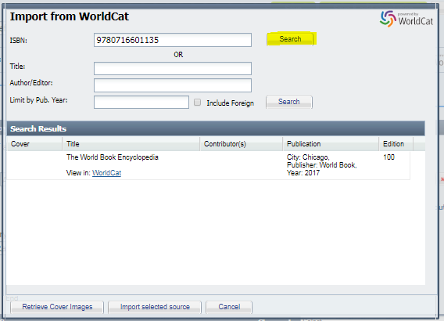
Noodletools Sources: Citing Encyclopedias
1

Slide 11
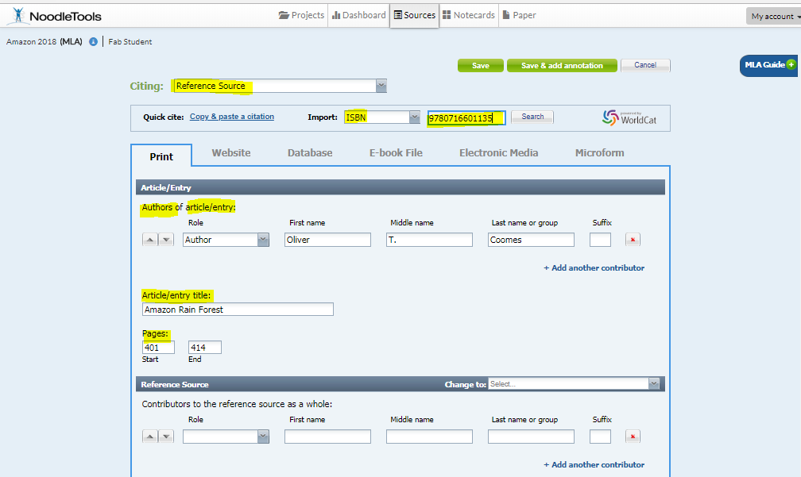
Noodletools Sources: Citing Encyclopedias
1
Fill in information about the article in your encyclopedia.
2
Fill in and scroll down
3

Slide 12
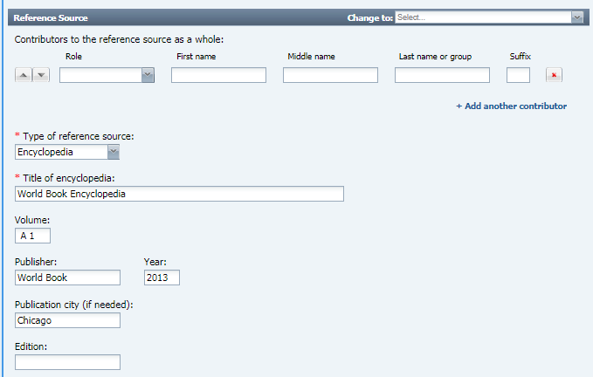
Noodletools Sources: Citing Encyclopedias
1
3
Fill in information about your encyclopedia.
Scroll down
SAVE

Slide 13
Noodletools: Works Cited
with Book and Encyclopedia Entry

