Slide 1

Veteran’s Day
& Noodletools 2018
Marvelous Ms. Lorenz ☺
Presentation created by Lynn Murray
October 2018 5 2

Slide 2

Research Steps

Slide 3
Outline Questions for Noodletools : (Slide #3)
Time Period Questions
What is your time period called?
Explain some events that occurred during your time period?
When did your time period take place?
Why is your time period important?
Military Conflict Questions
Describe what happened during the military conflict.
Who was involved in the conflict? Individuals and groups.
Who served?
Who was in support of the USs involvement in the conflict? Who was not?
Questions for Veterans
What was basic training like?
What was life like in the armed forces?
What was life like back in the US?
What is the history of your armed force?
What was their role in a particular war or peacetime?

Slide 4
Resources ☺
Resource #1=Destiny: Library Media Center’s book catalog
At TOR & Home: TORonline.org>Media Policies>TOR Media Center>TOR
-Catalog tab
-Scroll down to Destiny Book Catalog & SPS Database Access
-Search a topic, book title, or author by Reading Level and/or Interest Level
      -Locate the book by its call number, title or author
Resource #2=World Book Encyclopedias
Resource #3= Grolieronline: Encyclopedia text
At TOR & Home: TORonline.org>Media Policies>TOR Media Center>TOR
-Scroll down to Destiny Book Catalog & SPS Database Access
-Grolier Online
Resource #4=Newsbank=Historical and Current Newspaper text
At TOR & Home: TORonline.org>Media Policies>TOR Media Center>TOR
-Scroll down to Destiny Book Catalog & SPS Database Access
-Click on the NewsBank KidsPage for newspaper text that’s written at lower reading levels
-Click on the Access World News - International and Domestic Perspectives for
Research Papers, Debate and Speech for fantastic newspaper text

Slide 5
Grolier

Slide 6

Destiny Book Catalog & Database Access

Slide 7
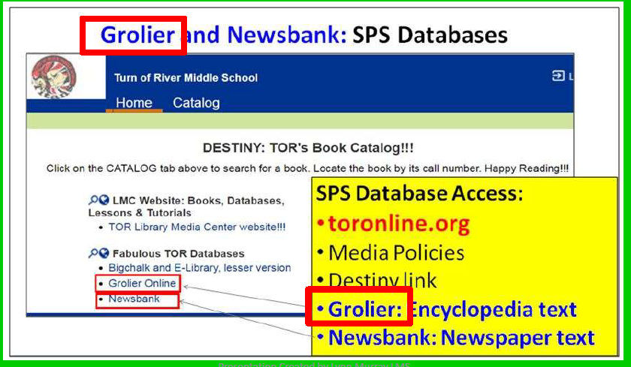

Slide 8
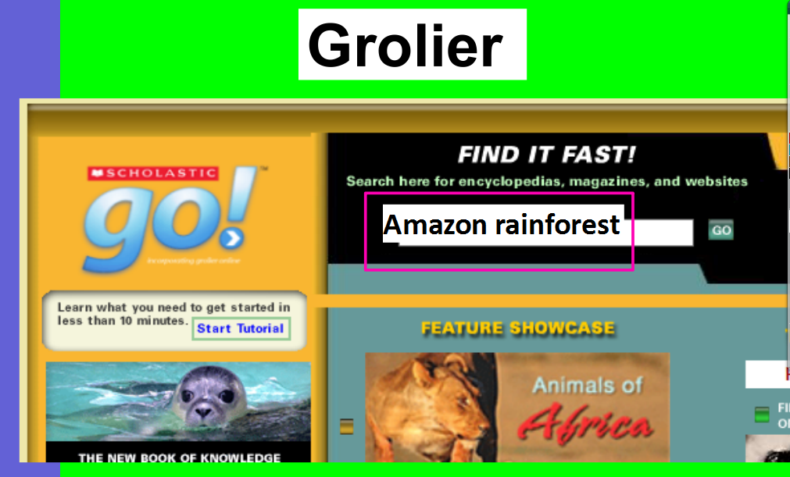
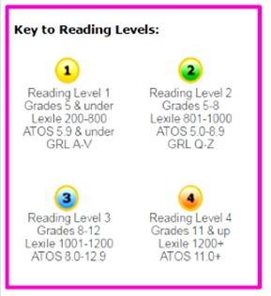
Vietnam War

Slide 9
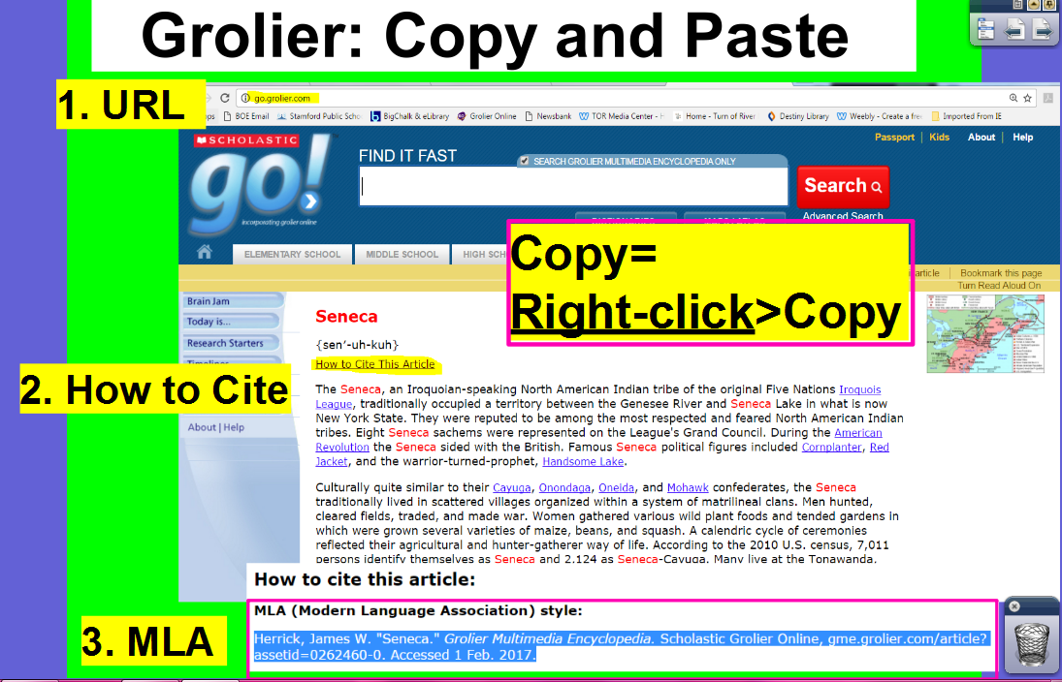

Slide 10
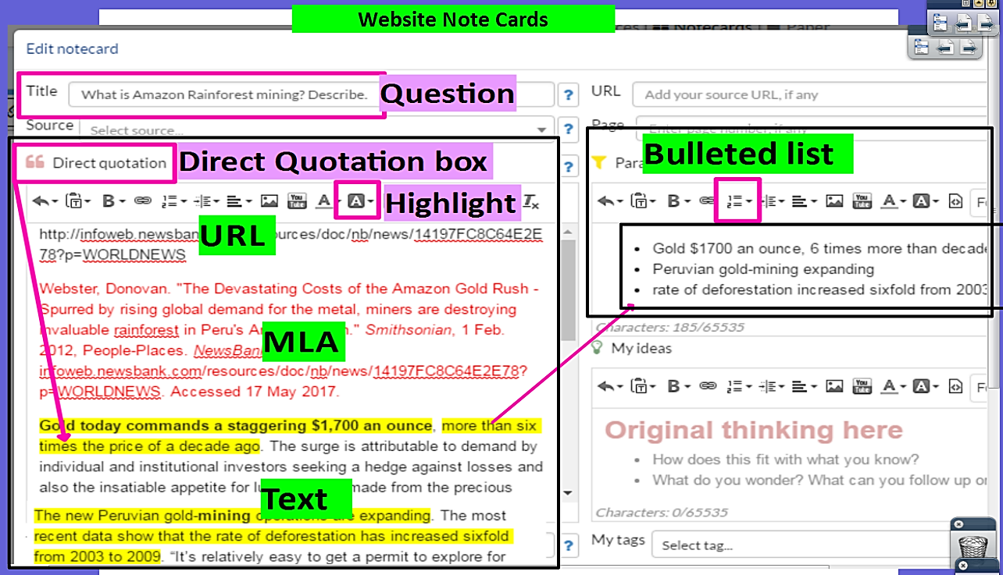
Noodletools Website Note Card
QUESTION
ANSWER

Slide 11
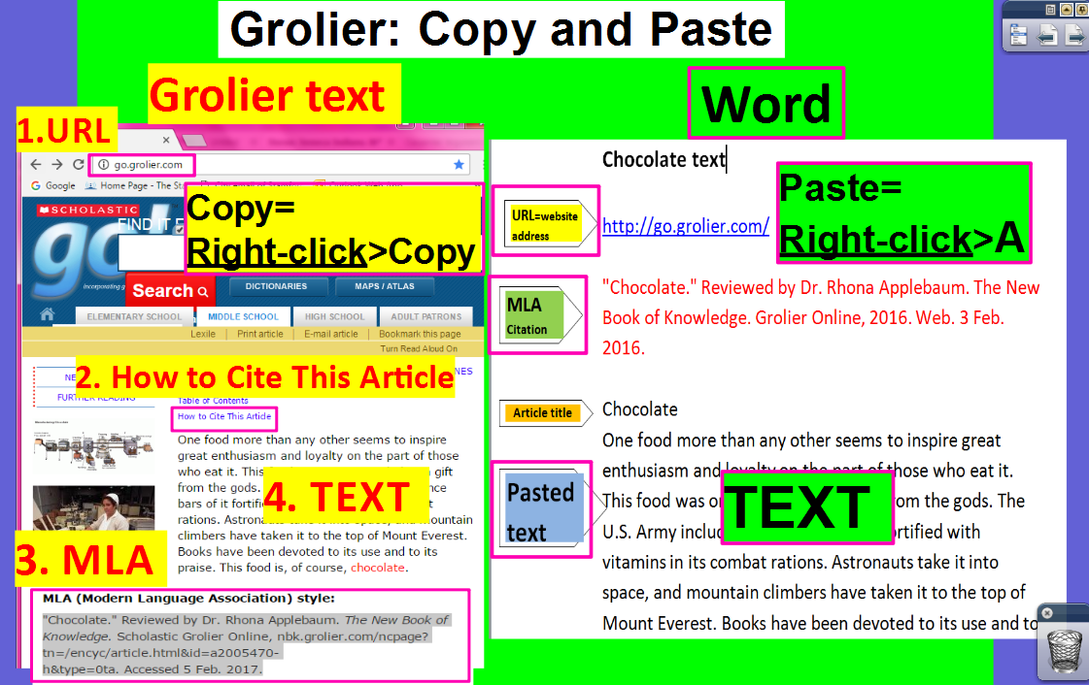

Slide 12
Newsbank

Slide 13
Destiny Book Catalog & Database Access

Slide 14
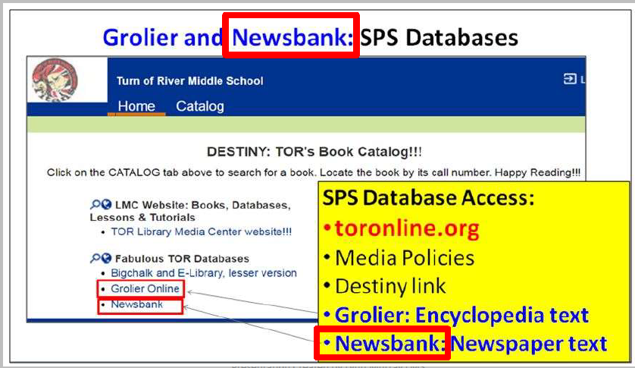

Slide 15
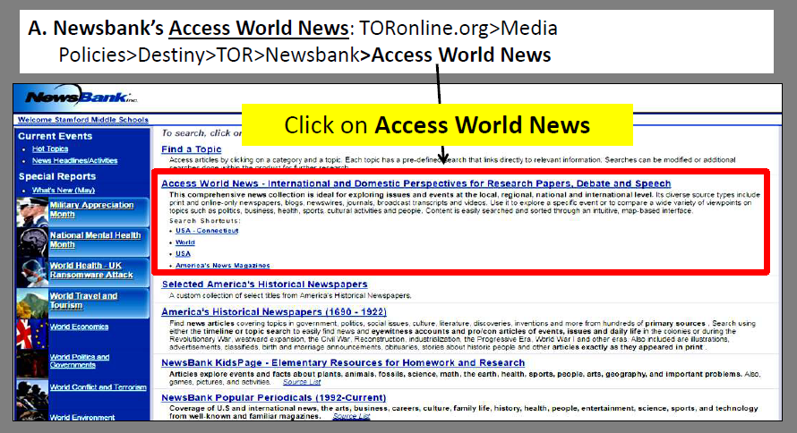
Newsbank is AWESOME!!!

Slide 16
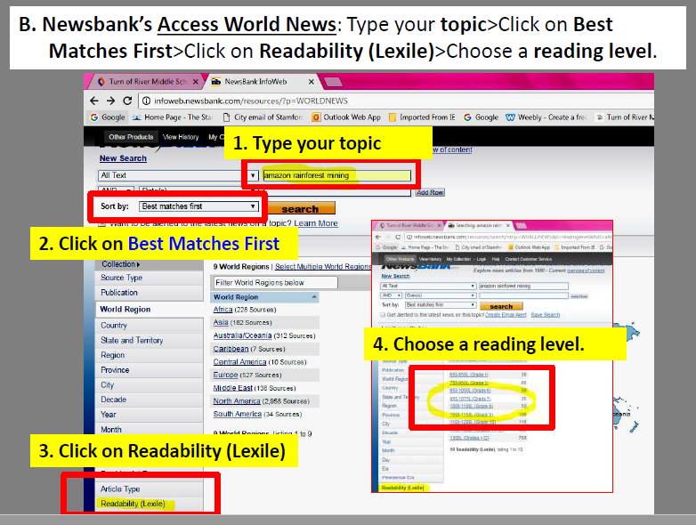
Newsbank Access World News

Slide 17
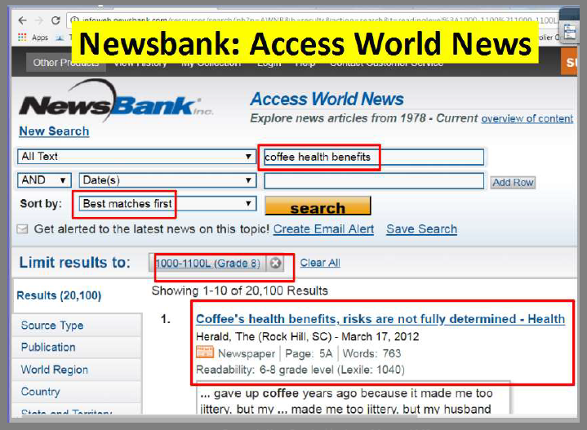
Newsbank Access World News

Slide 18
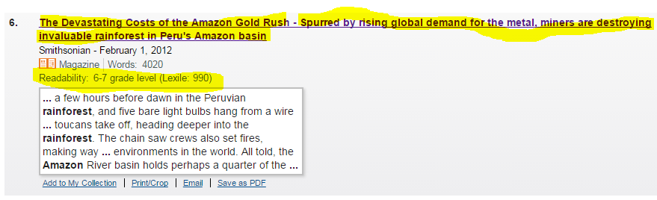
Newsbank is AWESOME!!!
C. Scroll down and read through the titles and abstracts. Click on a title that looks good.
Wow!!!

Slide 19
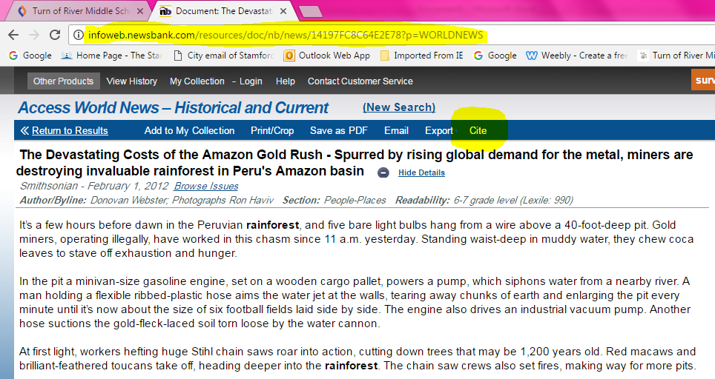
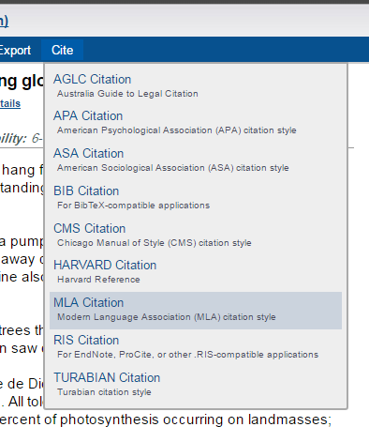
Newsbank is AWESOME!!!
D. READ the article!!!! Copy the URL, MLA citation and text about your topic.
URL
Cite
MLA Citation
Text about
your topic!!!

Slide 20
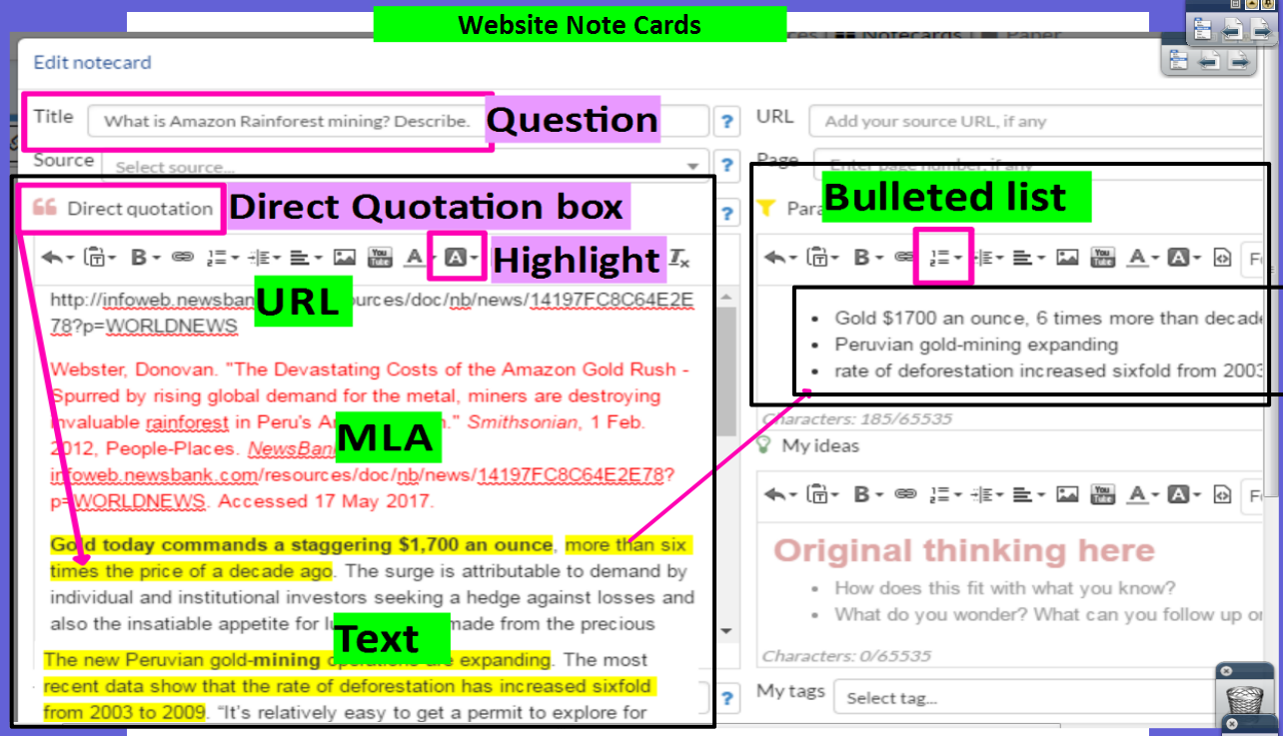
Copy and paste database text into the Direct Quotation box on Noodletools. Organize text onto “mini” Cornell Notes.
Noodletools Website Note Card
“Mini” Cornell Notes

Slide 21
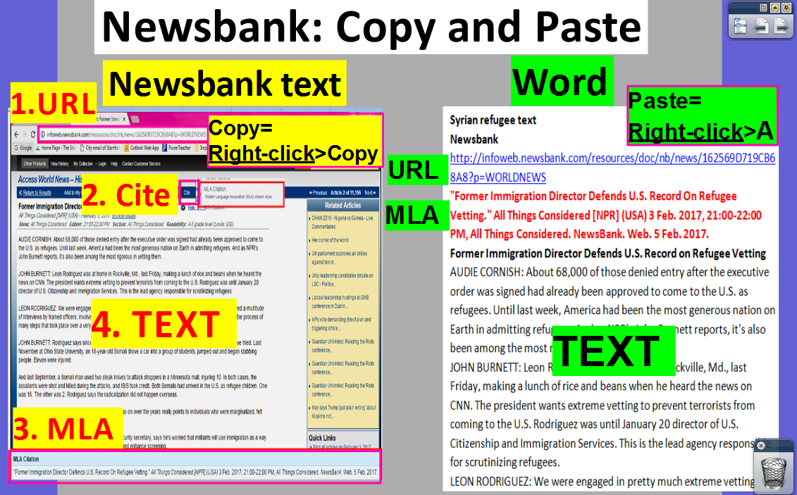

Slide 22
Newsbank Kidspage

Slide 23
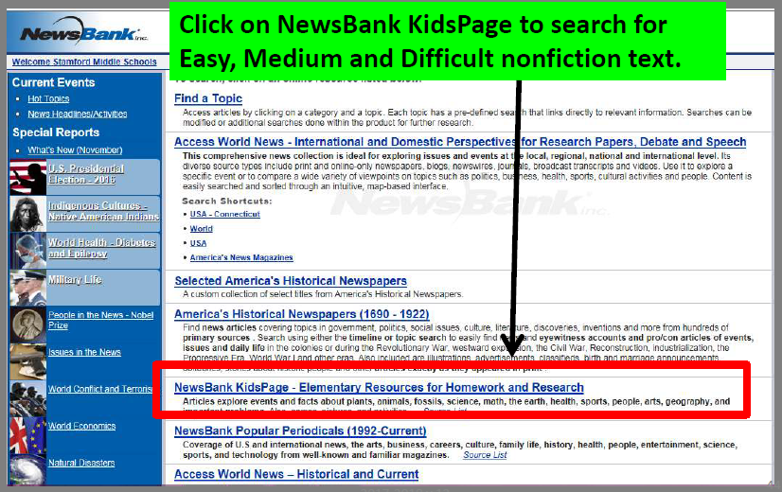
Newsbank Kidspage

Slide 24
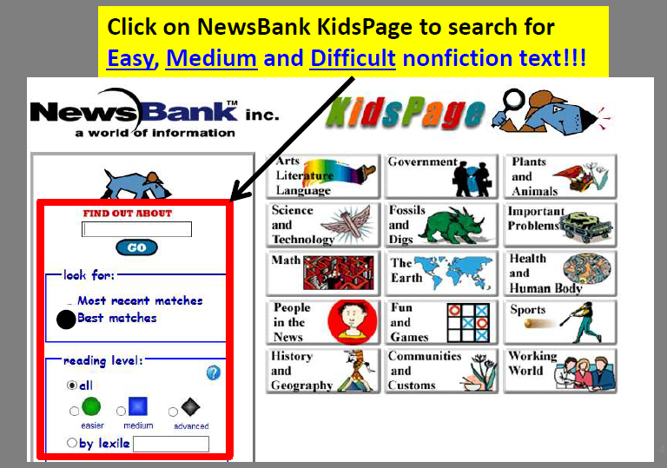
Newsbank Kidspage

Slide 25
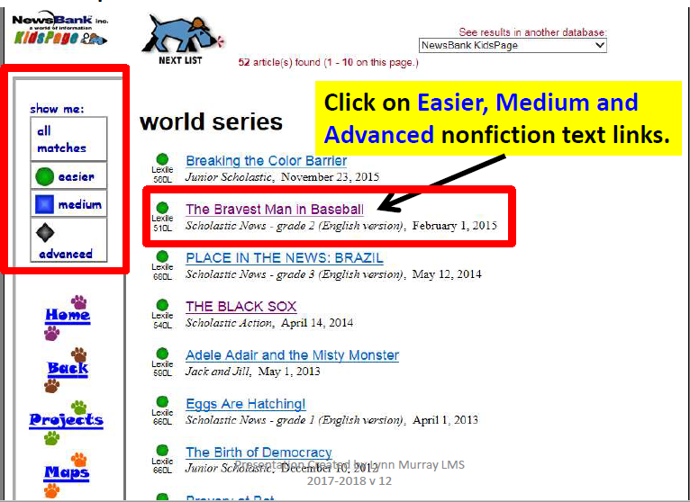
Newsbank Kidspage

Slide 26
Copy and paste database text into the Direct Quotation box on Noodletools. Organize text onto “mini” Cornell Notes.
Noodletools Website Note Card
“Mini” Cornell Notes

Slide 27
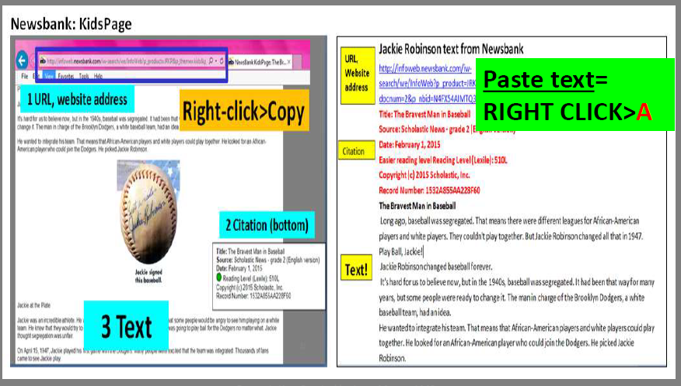
Newsbank Kidspage

Slide 28
Noodletools
It’s a website that allows you to organize your outline, note cards, and Works Cited information online!

Slide 29
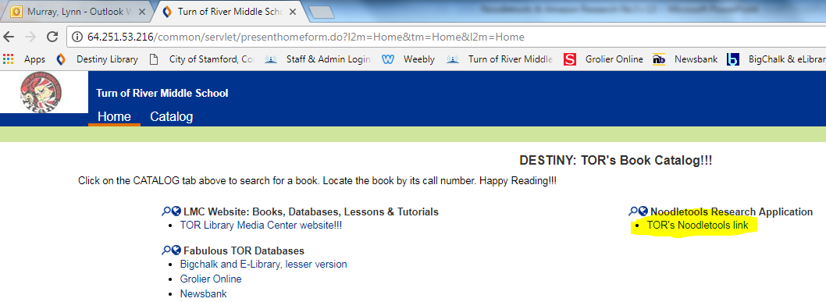
Noodletools Link

Slide 30
To begin copy and paste TOR’s Noodletools subscription address…
http://www.noodletools.com/login.php?group=9804&code=1860

Slide 31
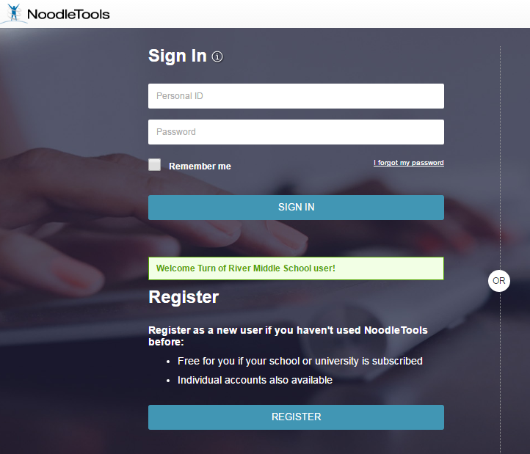
Register

Slide 32
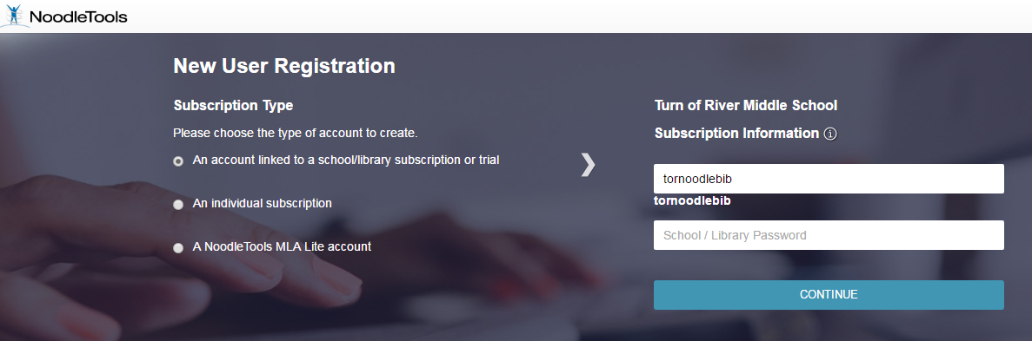
tornoodlebib1
Created & Updated by Lynn Murray February 2016

Slide 33
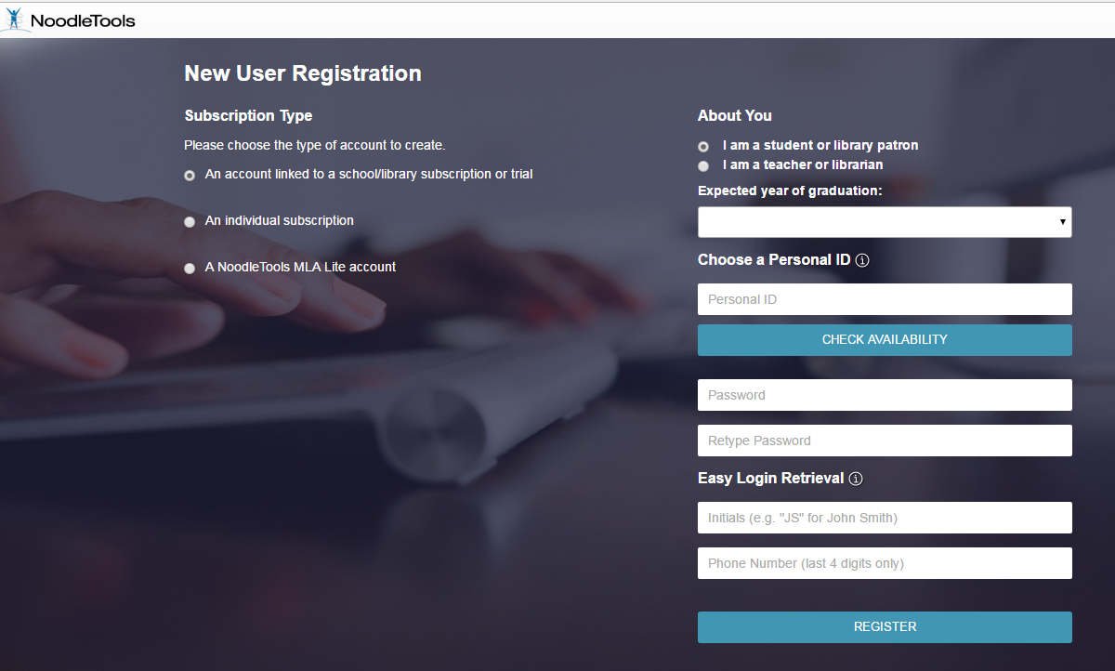
2019
Personal ID= first initial, last name
Password= computer login number
78830224
ZZ
2040

Slide 34
Register

Slide 35
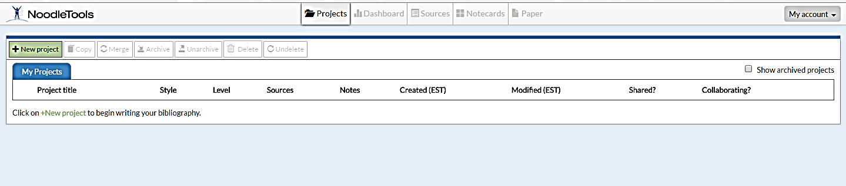
Click on +New Project to begin a new research project.

Slide 36
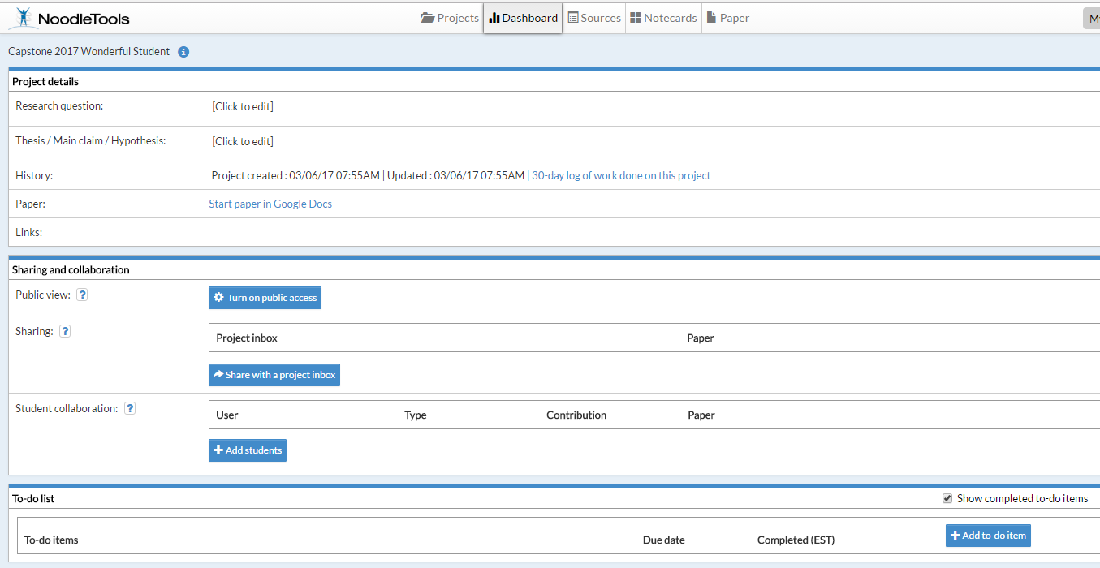
The Dashing Dashboard
    Click to edit to type your RESEARCH QUESTION. Example=What’s important about your veteran’s time period?
Created & Updated by Lynn Murray February 2016

Slide 37
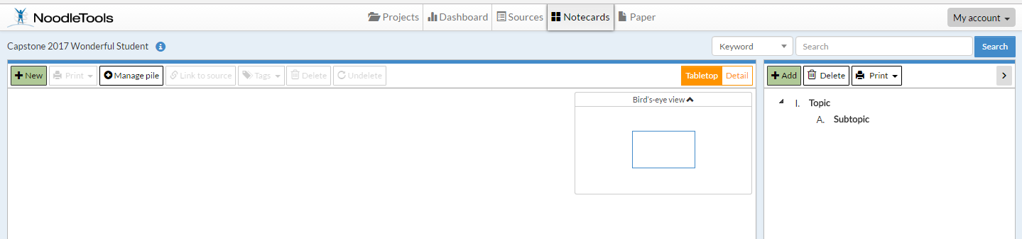
Click on Notecards: Create an outline about your topic.

Slide 38
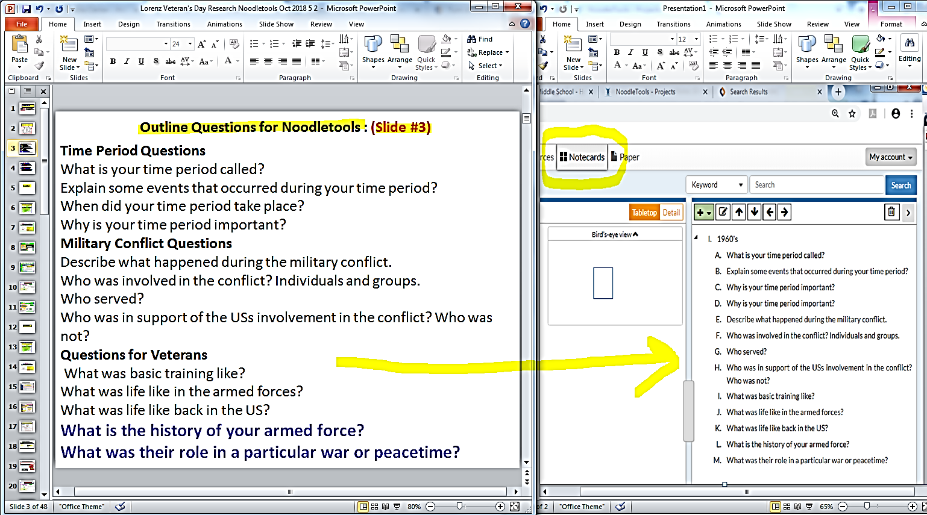
Slide #3
Noodletools:
Notecards & Outline

Slide 39
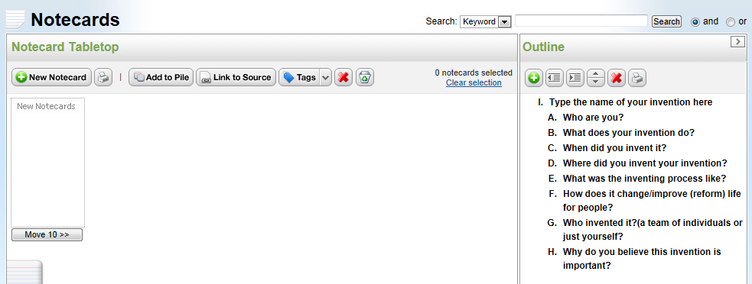
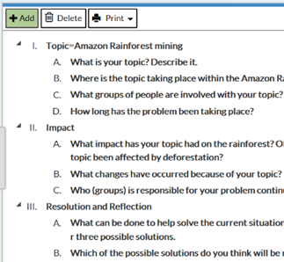
Click on New Notecard to begin taking notes about your topic.
Sample outline

Slide 40
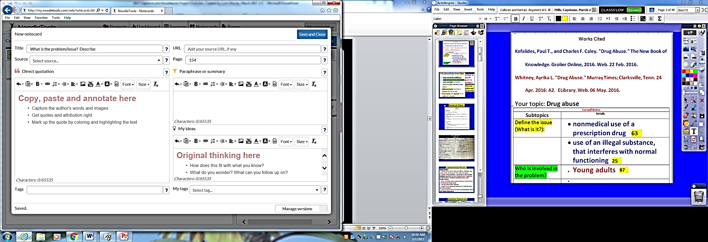
Note Cards ☺ Website
What is the problem? Describe 2
Bullets and Lists
Copy, paste and highlight text here.

Slide 41
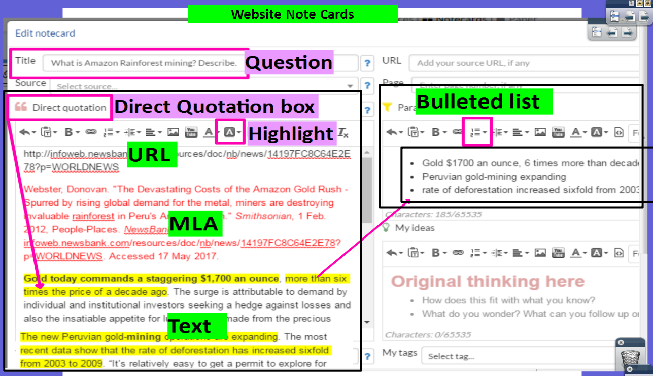

Slide 42
Book Note Cards on Noodletools
Slide 42

Slide 43
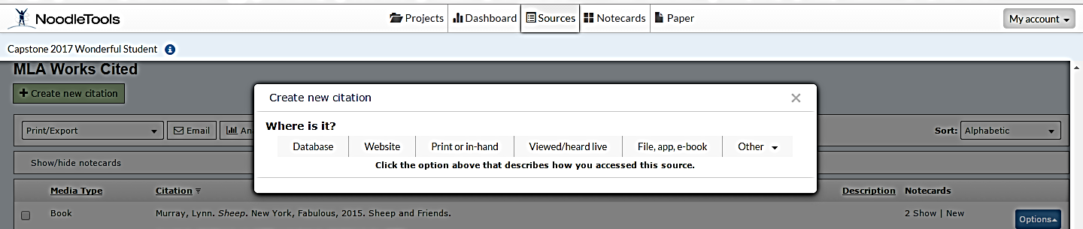
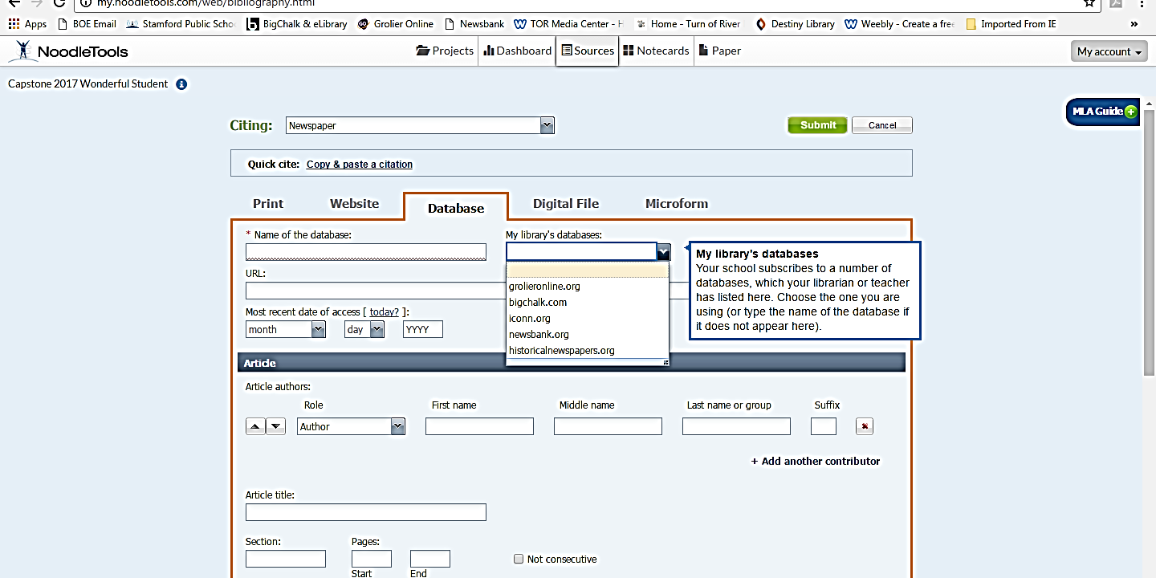
Book Sources on Noodletools
1
3
2
Book
4

Slide 44
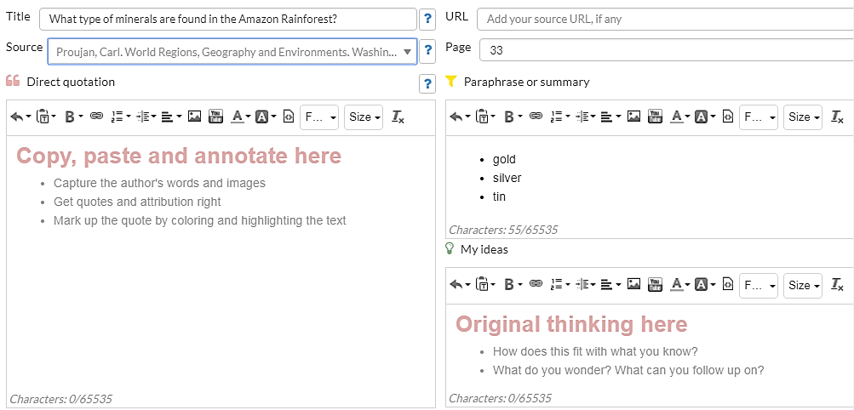
Note Cards ☺ Book
Question: Explain some events from your time period.
Book Source
Book information
Bullets and Lists
Draft
Vietnam War
Bulleted Answer
Summarize your notes here.

Slide 45
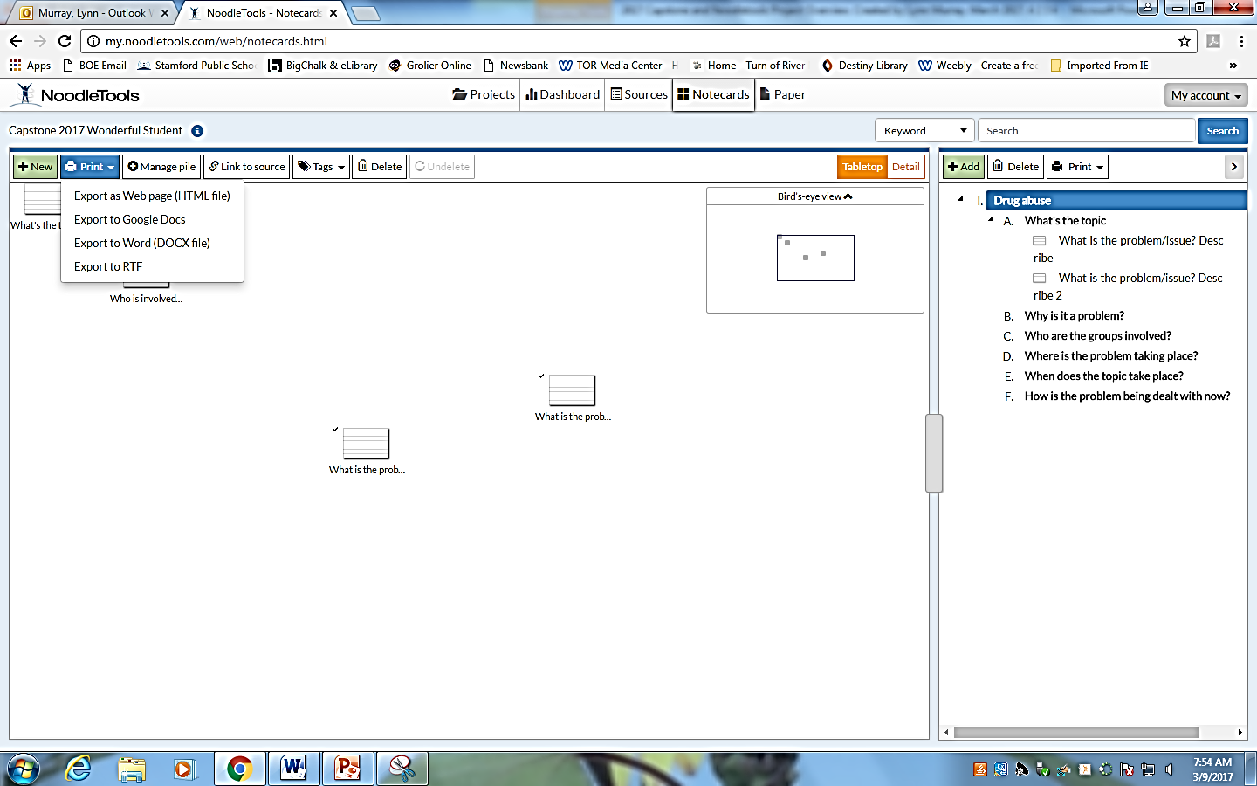
Note Cards on Dashboard
Print>Export to Word

Slide 46
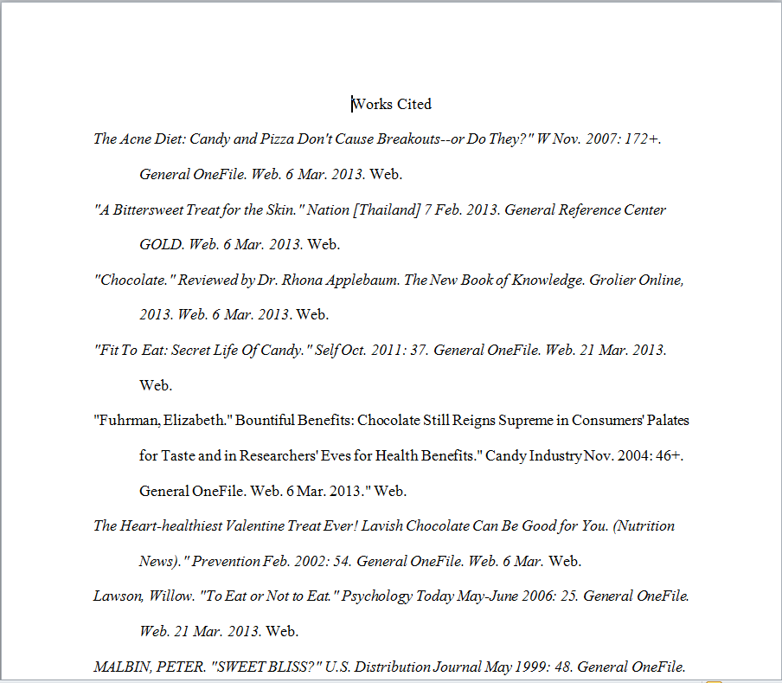
Create a Works Cited page. Copy and paste the MLA citations from your Notecards in alphabetical order to create a Works Cited page.
What is a Works Cited page?
It's a listing of book and computer sources that you used for your paper or project.
Each source (entry) is listed and alphabetized by its MLA format.
It's the last page of your paper and it's entitled Works Cited at the top.
Formatting requirements of the Works Cited page:
Double spaced.
Times New Roman font.
12 sized font.
Hanging indent. The first line is not indented. All of subsequent lines are indented, however.
Sample Works Cited

Slide 47
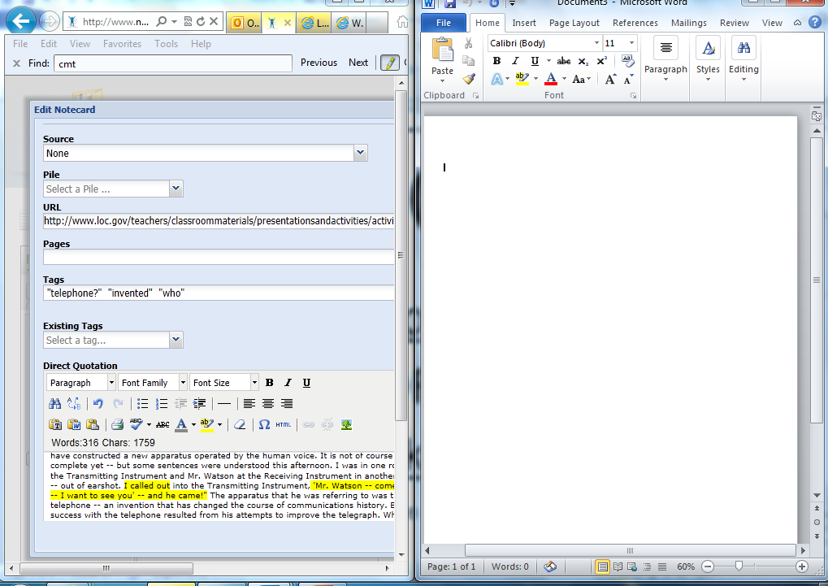
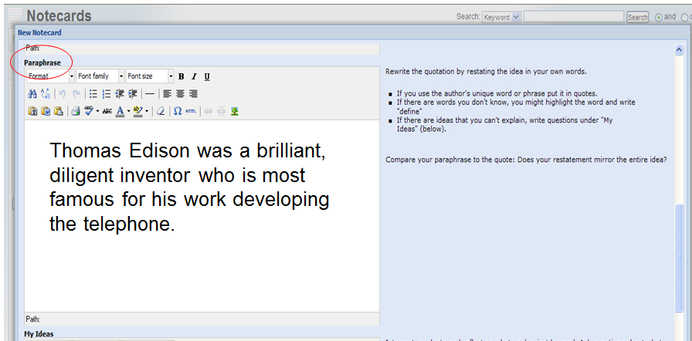
Split the screen so your notecard is on one side and Microsoft Word is on the other. Create your masterpiece on the right!
Open Word and split the screen to write your paper. Place Noodletools on your left and Word on your right. Look at your paraphrased information on the left to write your final masterpiece paper.
Use the Paraphrase section of your note cards to create your paper.
Create your masterpiece based upon your notecards here!

Slide 48
Good job!
☺
You Rock!!!

